Slide 1

Enhancing Cybersecurity for SMEs in Albania
Through Cyber Hygiene & Cyber Principles

Slide 2
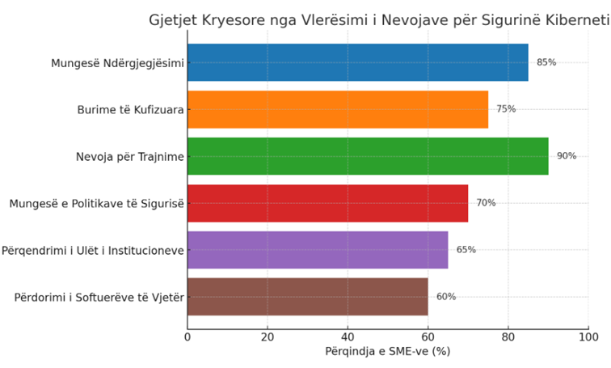
Why Was It Needed?
Assessment of 80 SMEs revealed:
85% poor awareness of cyber risks
70% no security policies
90% no training
75% no IT security staff
60% outdated software

Slide 3
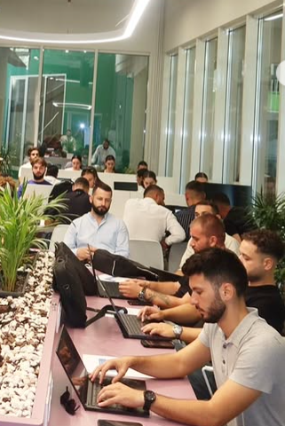
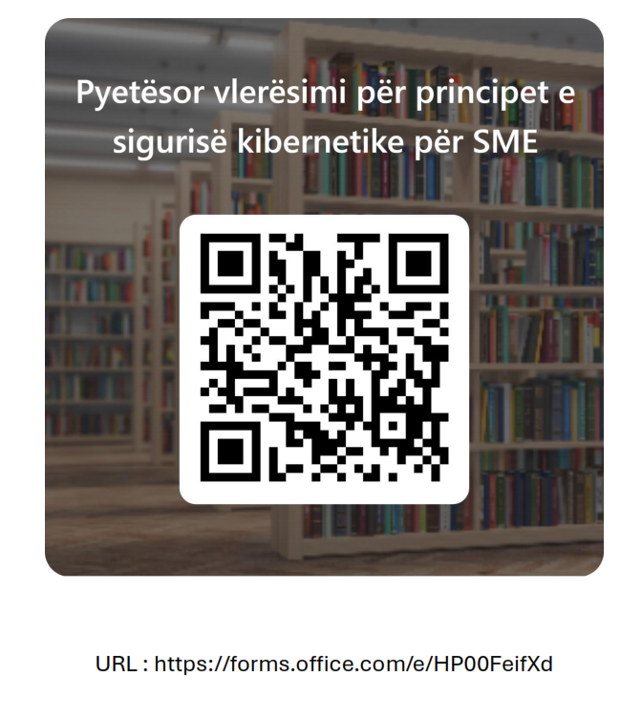

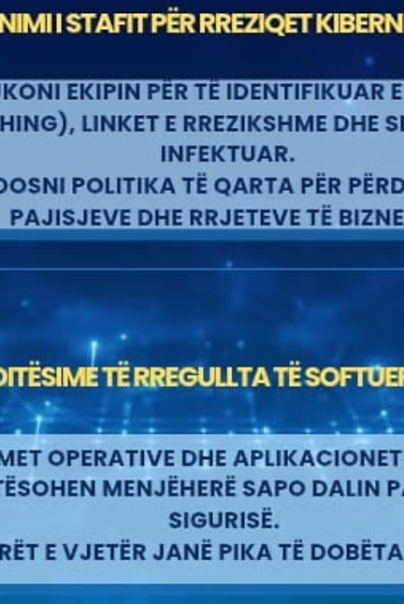
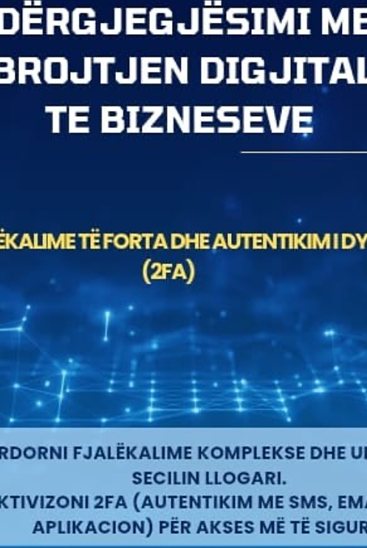
Approach & Methodology
4 Strategic Pillars:
Assessment – 80 SMEs
Cyber Principles Framework
Workshops & Cyber Hygiene Trainings
Awareness & Community Building

Slide 4
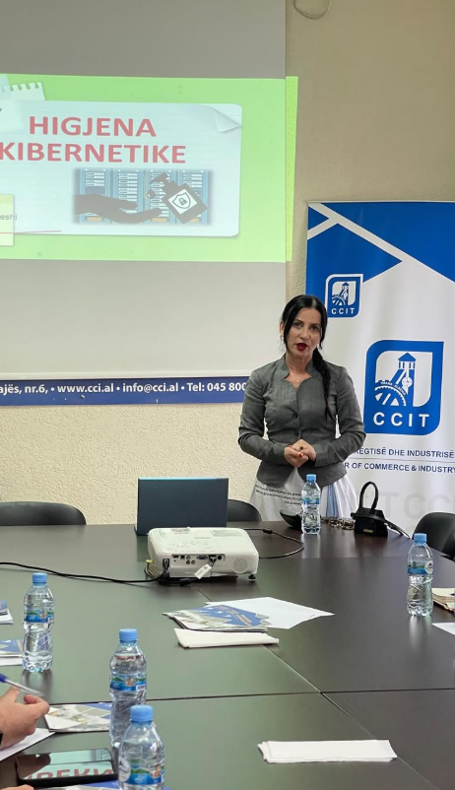
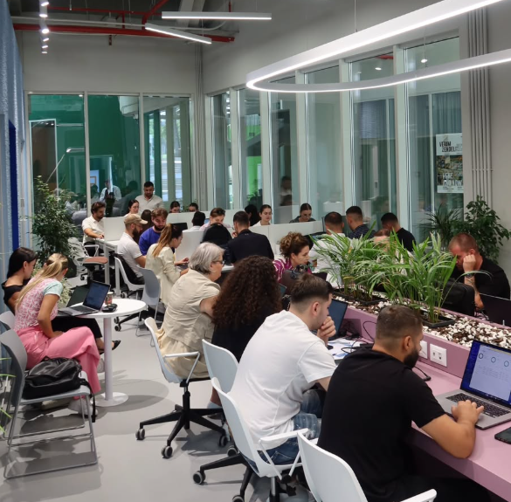

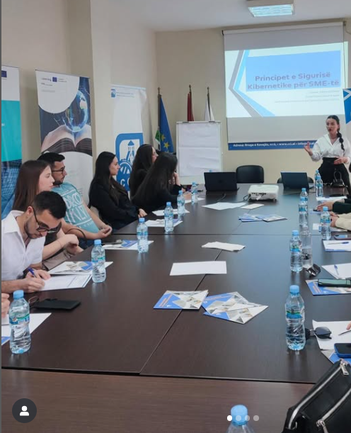
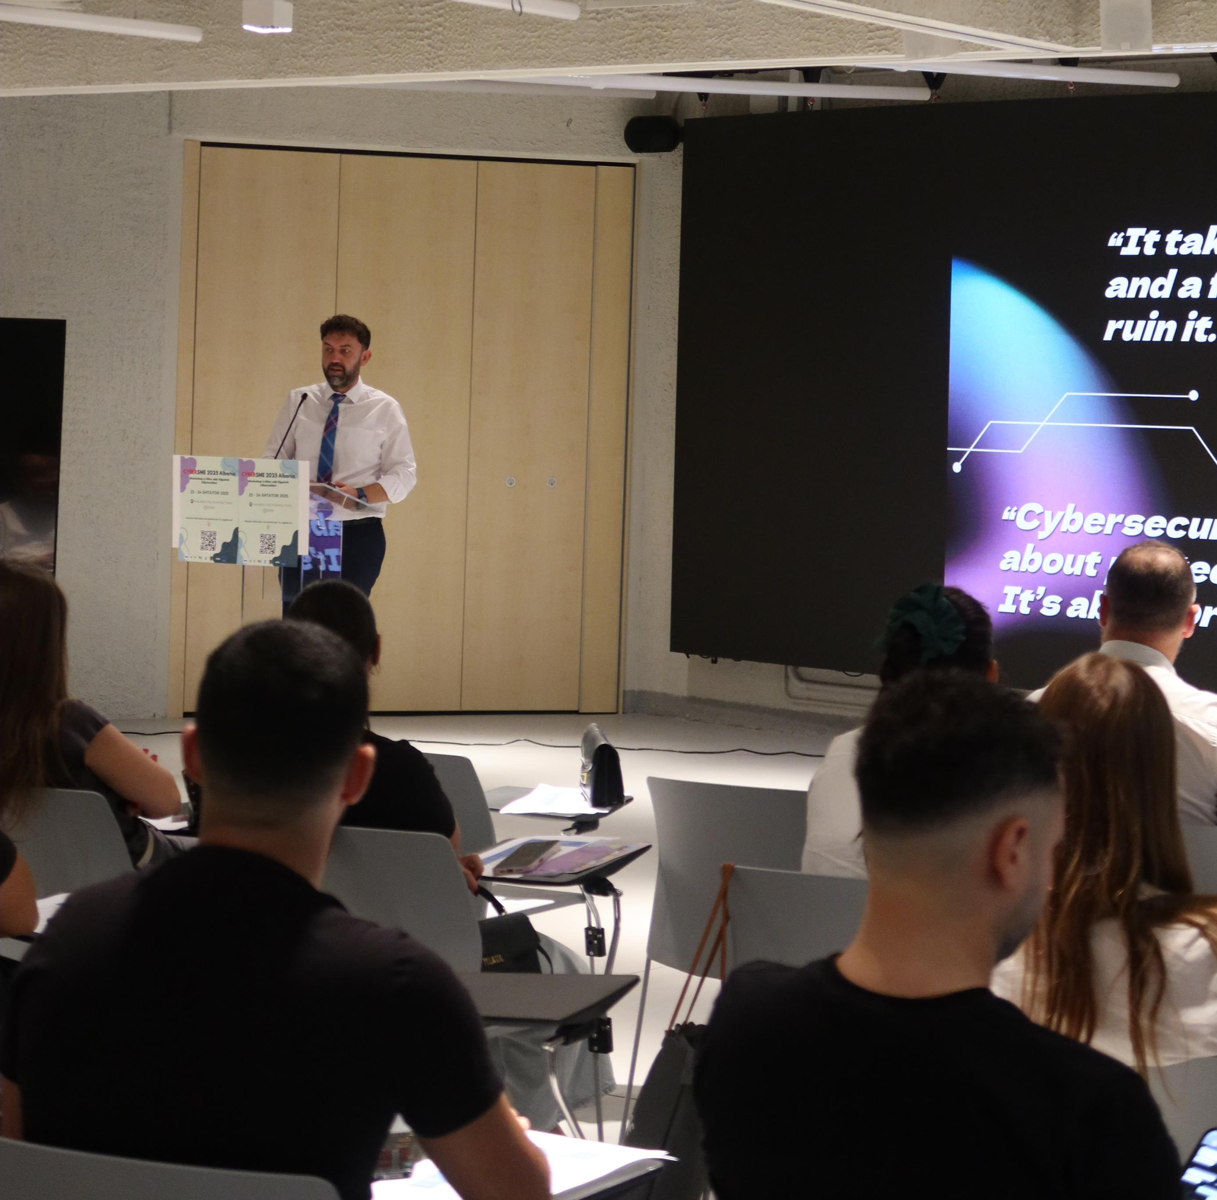
Capacity Building & Participation
Workshops & Practical Training ✔ 9 workshop days (theory, practice & TTX simulation) ✔ 250+ participants trained ✔ 40 SMEs applied Cyber Principles in practice

Slide 5

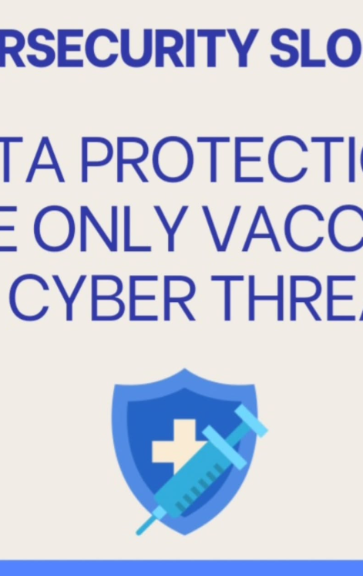
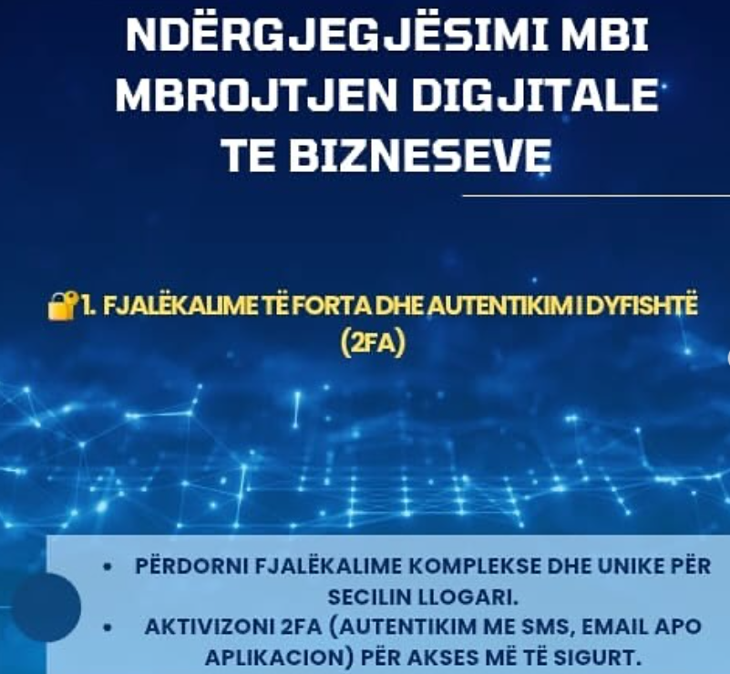
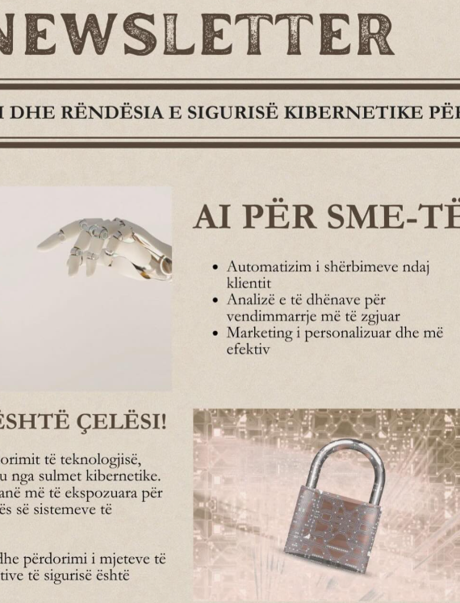
Capacity Building & Participation
Awareness & Communication Campaign
✔ 18 social media posts ✔ 4 newsletters to SMEs & partners ✔ 10,000+ online reach ✔ Flyers, banners & videos for visibility

Slide 6
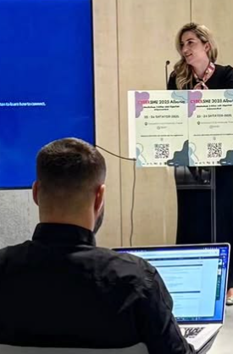
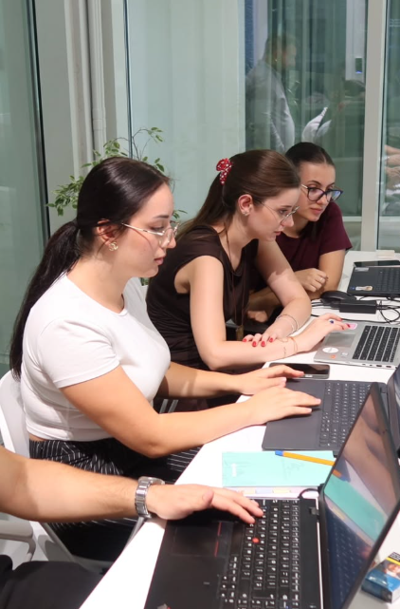
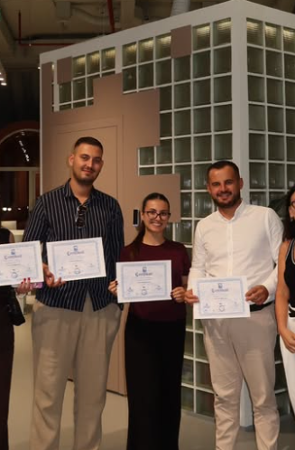

Measurable Results
Key Achievements:
80 SMEs assessed
4 Core Cyber Documents
10,000+ online awareness reach
+65% awareness increase
70% readiness for certification

Slide 7

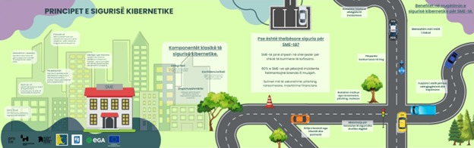
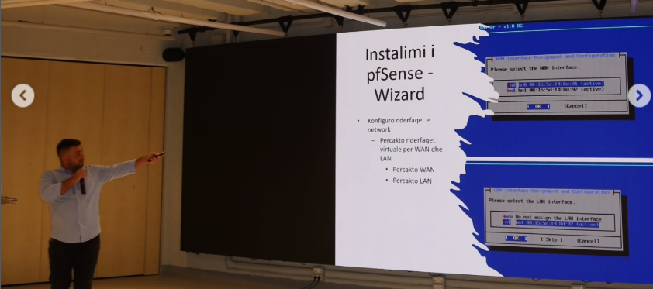

Impact
Fragmentation → Roadmap
No policy → Framework
No expertise → Trained SMEs
Isolation → Community of Practice

Slide 8
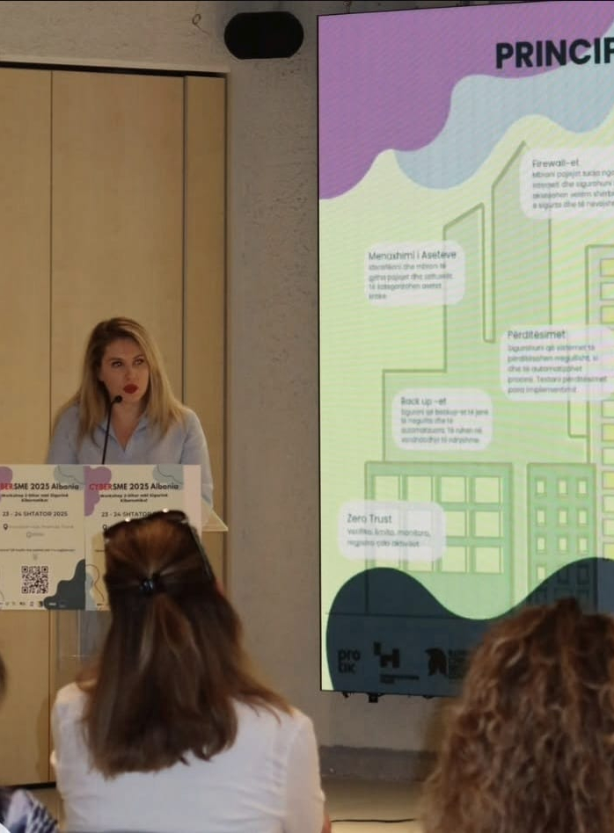
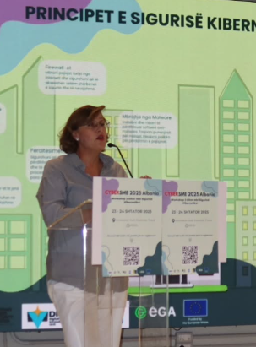
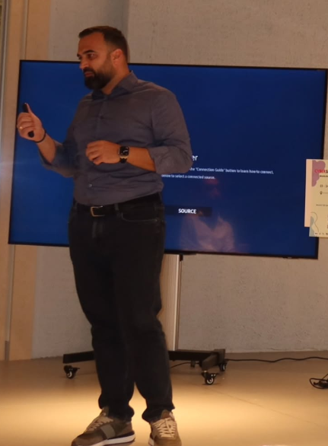
Scaling Up
Next Steps:
Cyber-Safe Certification Scheme
SME Cyber Help Desk / Hotline/CIRT
Advanced training modules
Institutional partnership expansion

Slide 9
Final Message
"Albanian SMEs can lead cybersecurity resilience in the Western Balkans."
Ready to scale!
Thank you!
keis.xhumari@icscenter.onmicrosoft.com
info@icscenter.onmicrosoft.com
info@forumcentre.org

