Slide 1
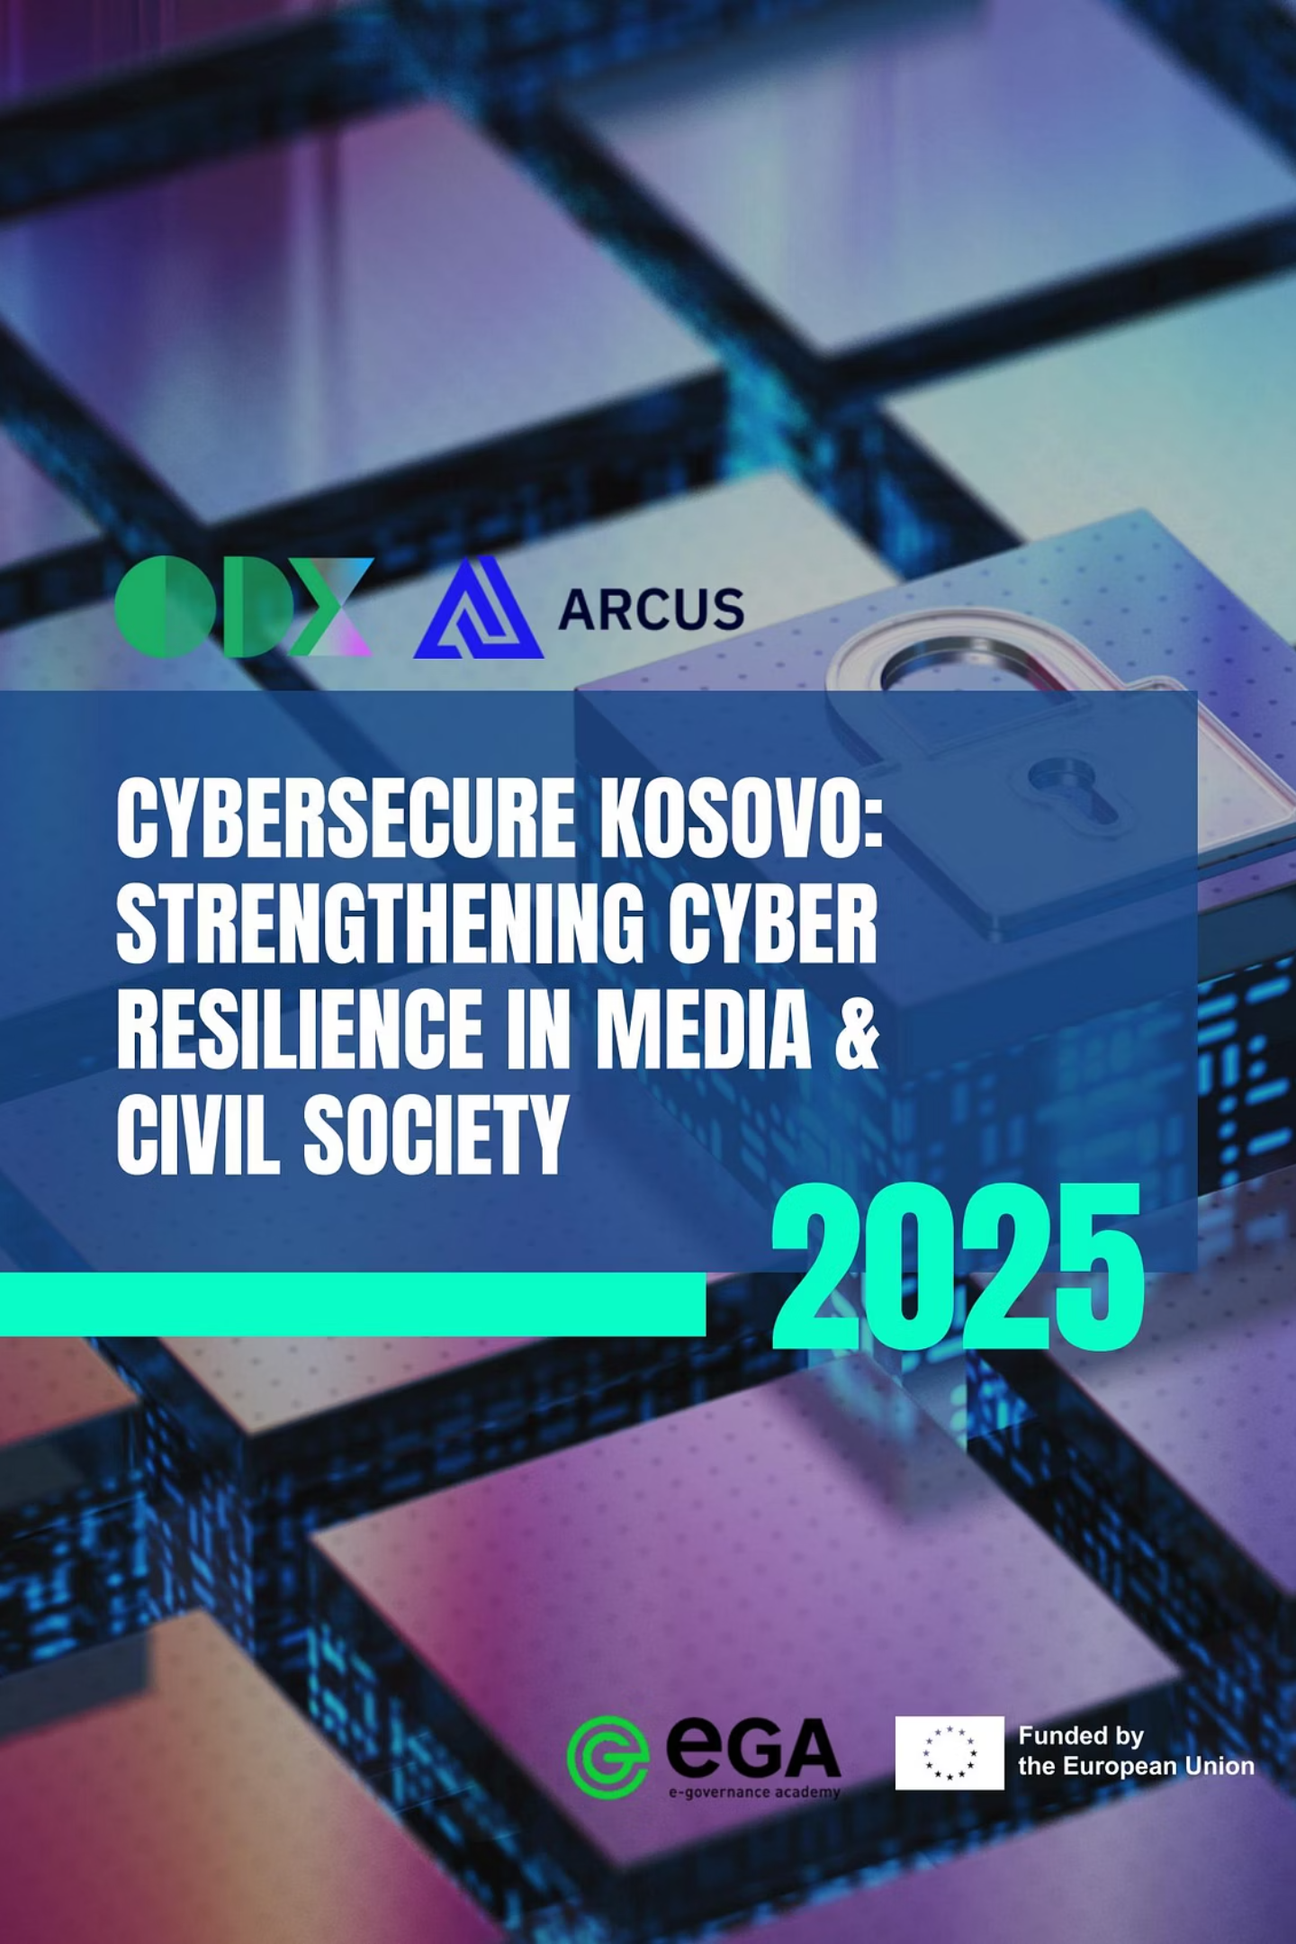
CyberSecure Kosovo
As digital threats grow more sophisticated, Kosovo’s media and civil society organizations (CSOs), which are key defenders of democracy, face increasing cyber risks that threaten their independence and daily operations.
To address this, Open Data Kosovo (ODK) and Arcus, with support from the e-Governance Academy (eGA) through the KnowCyber Grants for the Western Balkans, launched the CyberSecure Kosovo project.

Slide 2

Assessment Framework
Organizations were evaluated across 11 critical cybersecurity domains using a comprehensive scoring system.
Data Protection
Content Security
Classification, encryption, and backup practices
Securing digital content from unauthorized access or modification
Network Security
Endpoint Security
Firewall configuration and monitoring
Device management and software updates
Email Security
Identity & Access Management (IAM)
Authentication protocols and phishing defense
Controlling user access and verifying identities
Incident Response & Recovery
Compliance & Legal Requirements
Procedures, roles, and recovery plans
Adhering to laws, regulations, and industry standards
Employee Training & Awareness
Disinformation Defense
Training programs and security culture
Strategies to counter misinformation and protect integrity
Physical Security
Protecting physical assets from unauthorized access and damage

Slide 3
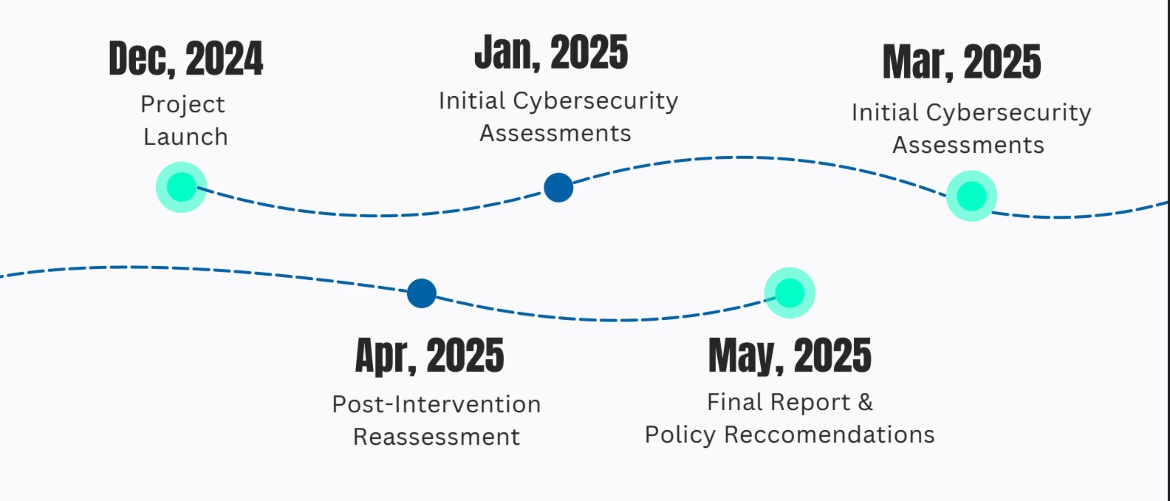
Timeline
3.49 to 4.07 in 6 months
Penetration Testing
Policy Development
Simulated attacks identified exposed admin panels and vulnerable software
Created governance frameworks, incident response plans, and security policies
Technical Configuration
Training Sessions
Implemented email security, MFA, and endpoint protections
Delivered phishing awareness and security best practices

Slide 4
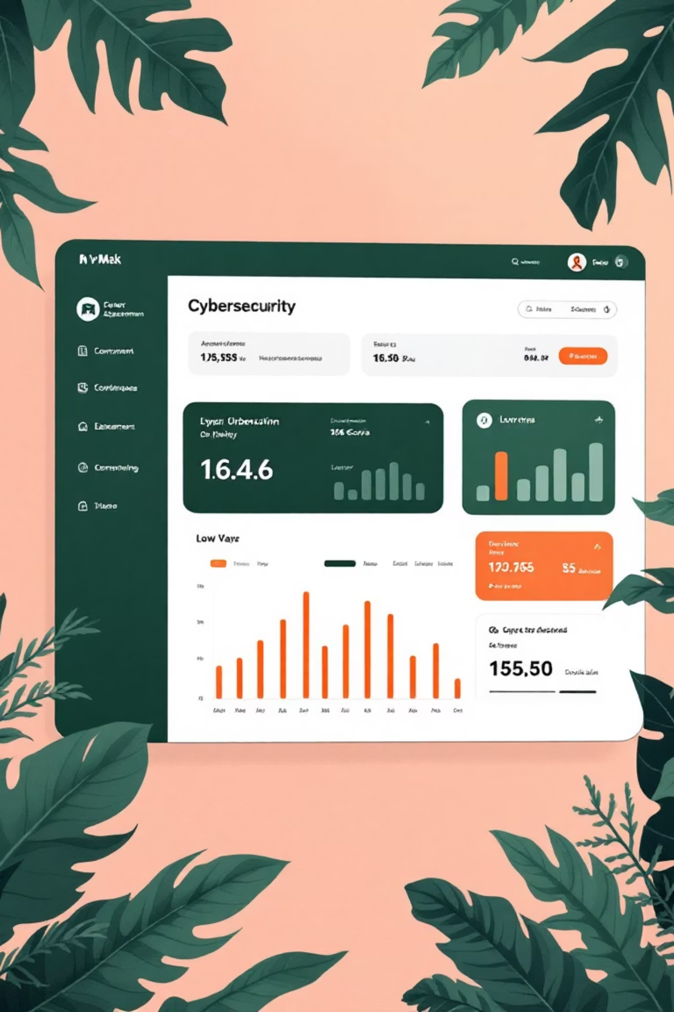
Urgent Cybersecurity Risks Exposed
3.49
1.06
9.33
Average Score
Incident Response
Disinformation Defense
Out of 10 across all organizations
Weakest domain with no formal procedures
Strongest area for media organizations
Initial assessments revealed urgent gaps in incident response, employee awareness, compliance, and endpoint security. Media organizations excelled at countering disinformation but struggled with broader IT security.

Slide 5
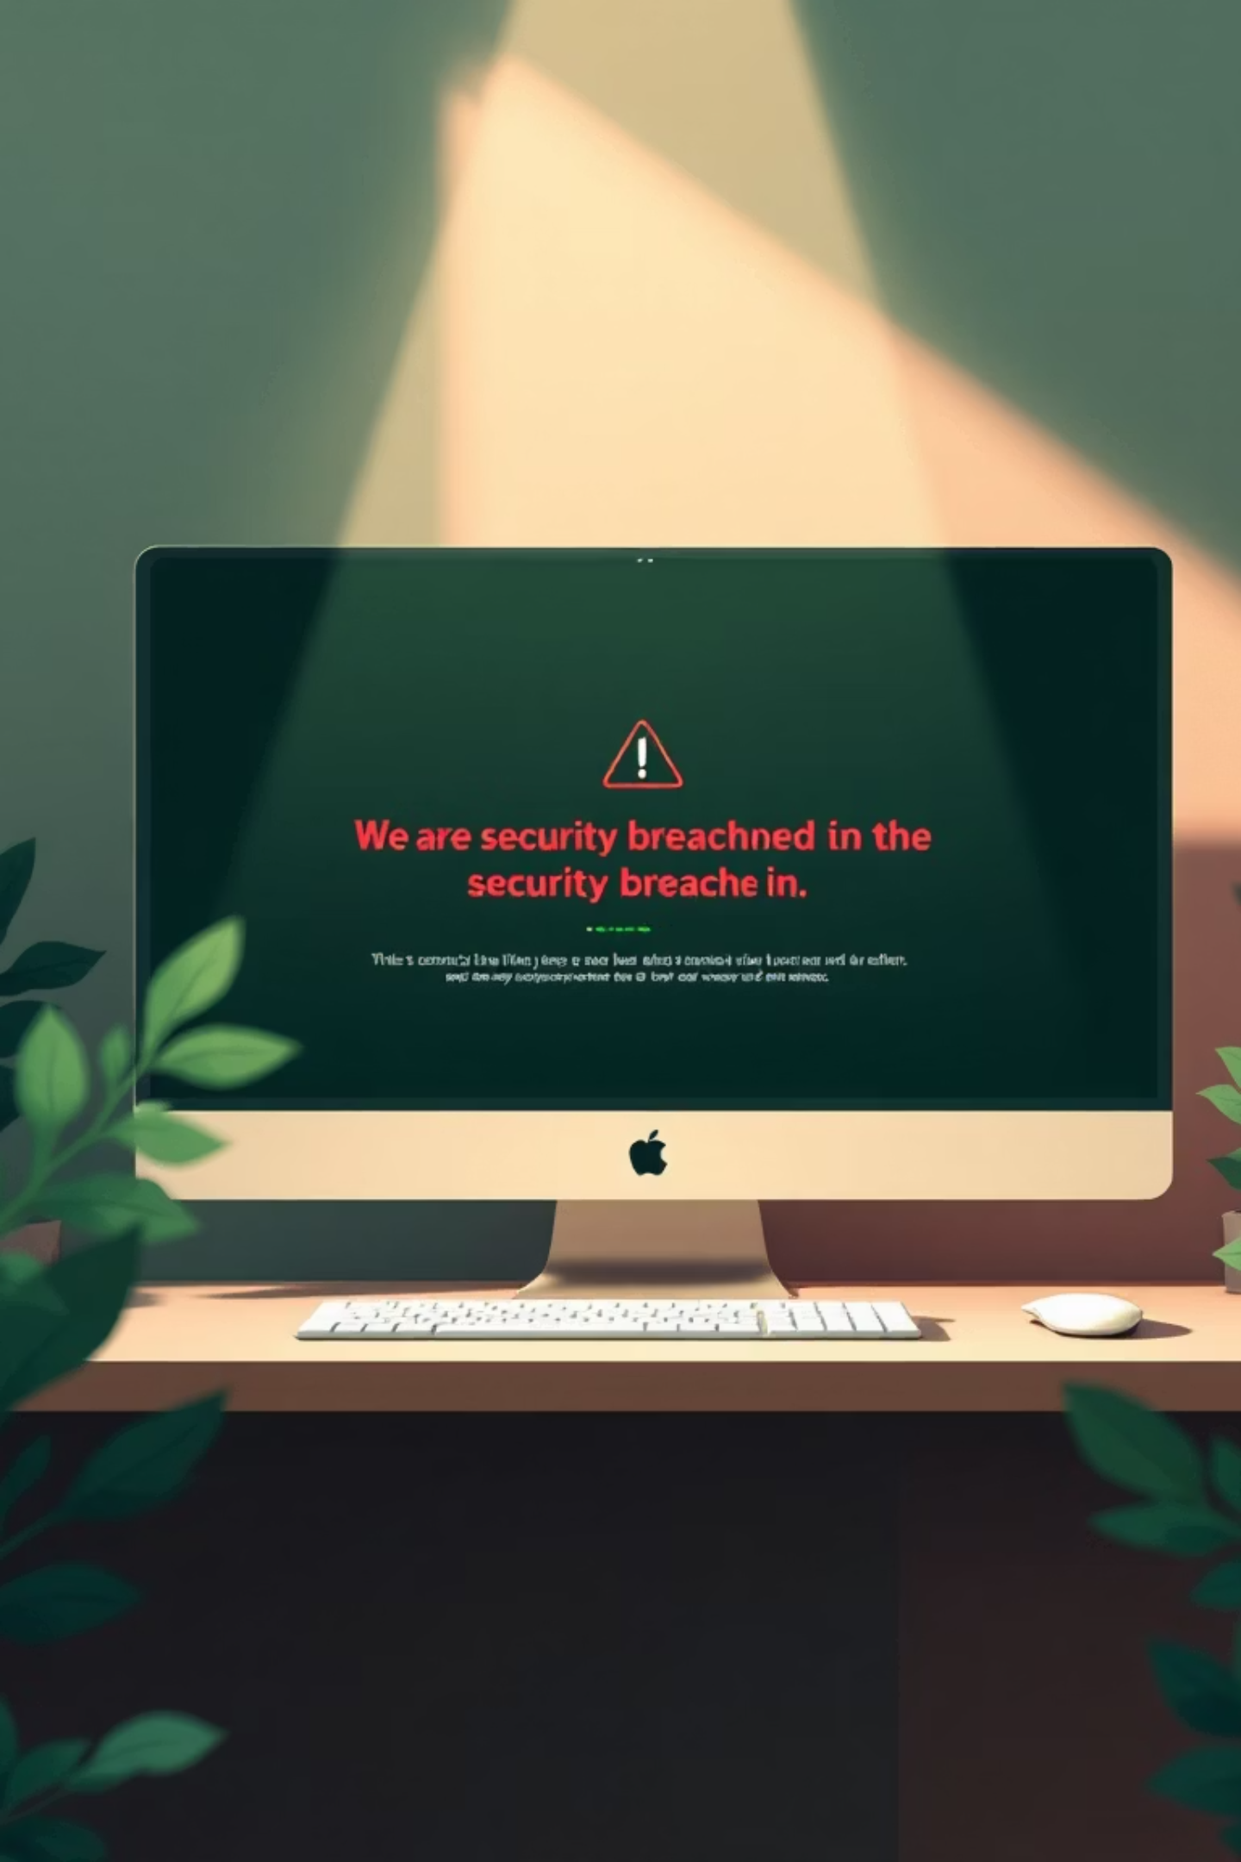
Critical Vulnerabilities Discovered
Exposed Data
A CSO publicly exposed sensitive beneficiary data through an unprotected Google Drive folder.
Weak Access Controls
WordPress admin panels accessible via simple URLs with no restrictions.
Shared Credentials
Protest volunteers coordinated via shared Gmail accounts without MFA, risking operational exposure.
No Response Plans
Organizations suffered breaches but had no documentation or response processes.

Slide 6
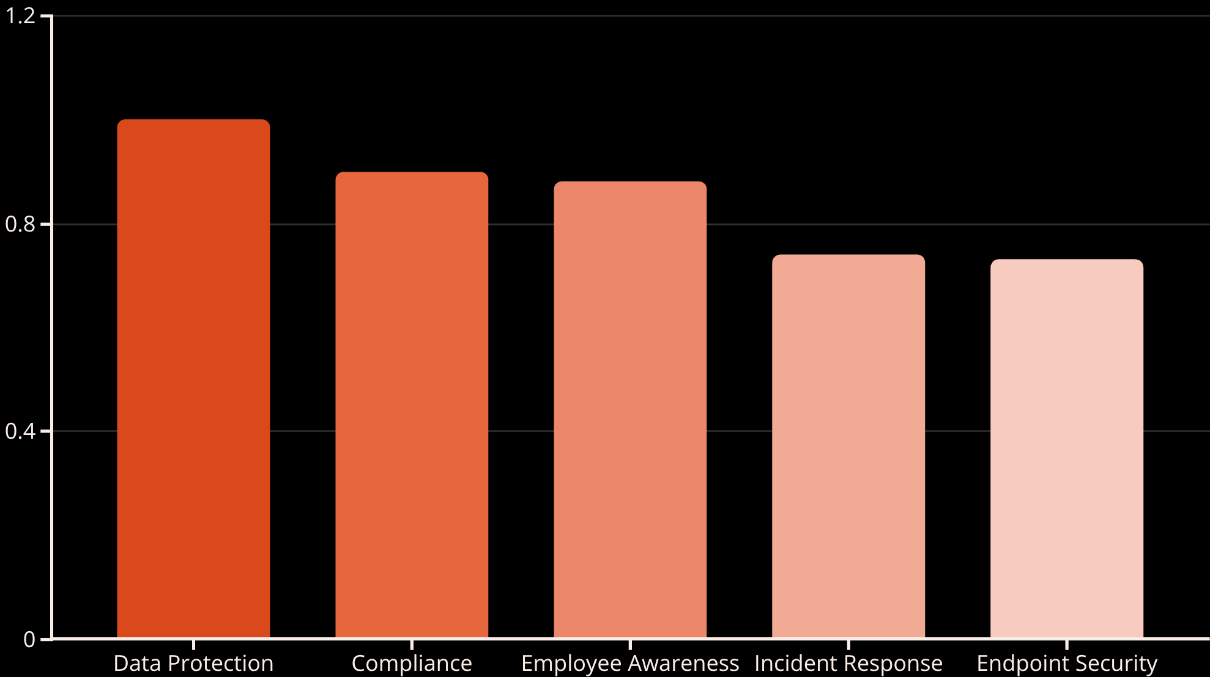
Measurable Progress
Score Improvement
Average cybersecurity score increased from 3.49 to 4.07 out of 10 following targeted interventions.
Most domains showed measurable improvement, confirming the value of tailored support and hands-on guidance.

Slide 7

Key Lessons Learned
Tailored Support Works
Policy Adoption Achievable
Organization-specific guidance and resources delivered the most improvement
Groups successfully implemented cybersecurity policies even without prior documentation
Training Delivers Quick Wins
Capacity Remains Limited
Awareness efforts led to immediate improvements in digital hygiene and behavior
Technical improvements requiring infrastructure progressed more slowly

Slide 8

A Call to Action
"Cybersecurity is no longer a purely technical issue—it is a democratic necessity. Without sustained investment, civil society in Kosovo will remain vulnerable to evolving digital threats."
1
Immediate
Establish cybersecurity policy toolkit and invest in leadership training
2
Short-Term
Create dedicated support mechanism for assessments, tools, and emergency response
3
Long-Term
Integrate security requirements into all donor contracts and national strategy
The threats are growing, but so is the readiness to respond. With the right support, Kosovo's civil society can build a secure digital foundation for years to come.

