Slide 1




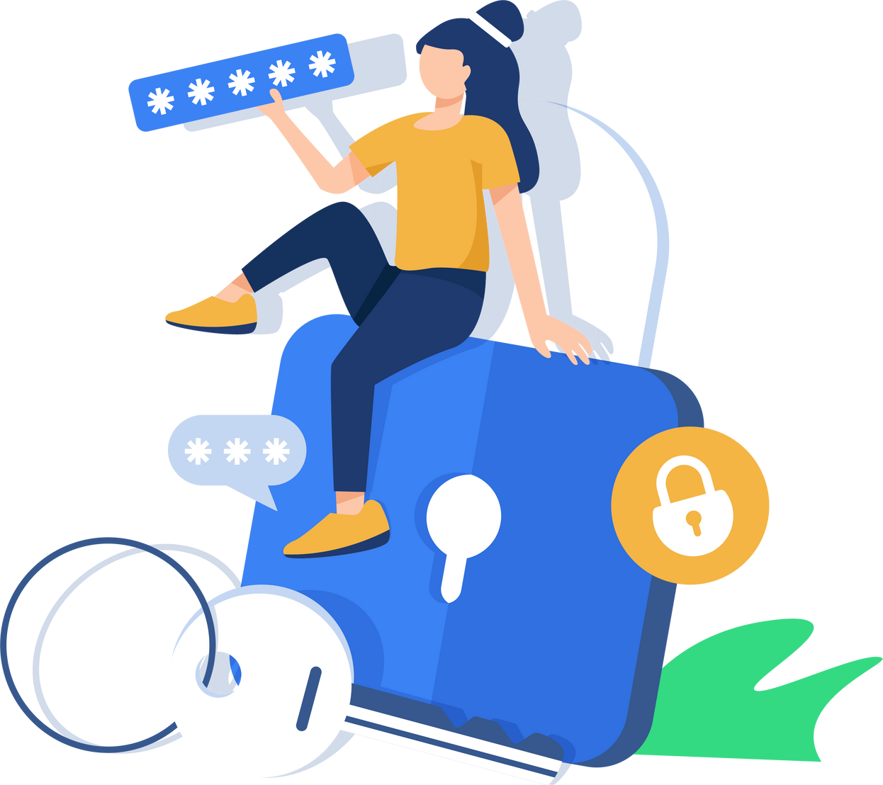

CYBERGUARD: PROTECTING THE VULNERABLE FROM ONLINE TRAFFICKING
ASTRA – ANTI-TRAFFICKING ACTION
IN PARTNERSHIP WITH E-GOVERNANCE ACADEMY EGA

Slide 2


“I TRIED TO DELETE THE APP, BUT HE ALWAYS KNEW WHERE I WAS.”

Slide 3



WHAT WE DID AND WHAT WE LEARNED
RESEARCH (85% deceptive job ads)
SURVIVORS TESTIMONIES
CASE STUDY
AWARENESS CAMPAIGN
ROUNDTABLE - UPCOMING

Slide 4



WHAT REMAINS AFTER THE PROJECT?
A foundation for future cross-sector cooperation on digital safety and anti-trafficking work
RESEARCH REPORT AND POLICY BRIEF
DIGITAL LEARNING RESOURCE
VICTIM NARRATIVES
COOPERATION BASE

Slide 5

BUILDING UP ON THE MOMENTUM
Integrate knowledge into schools. Strengthen digital-safety cooperation. Continue advocacy on online recruitment.

Slide 6
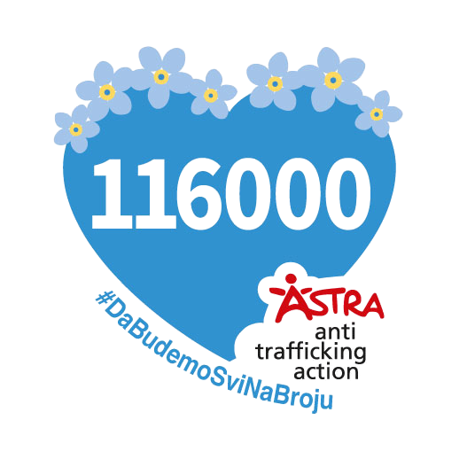
THANK YOU
IF YOU SEE VIOLENCE ONLINE — REPORT IT. REACT. YOUR REACTION MATTERS.
SUPPORT US AND THE ORGANISATIONS DOING THIS WORK
📫
ASTRA – Anti Trafficking Action
astra@astra.rs
www.astra.rs
+381117850000 / 116000 (24/7)

